Slide 1
Preface
Hello and Welcome everyone, In this presetation I will Try to show you our company’s Sales performance for the year 2010 and 2011.
I truly appreciate TCS for providing me opportunity to dive into this data to gain insightful information about the Store’s performance in different countries.
Thank you also for the explaining each step and providing with necessary resources to accomplish each task. These all together provide proper direction to work and successfully make this internship happen.

Slide 2
Thought Process
I assure you that I took all the necessary steps to ensure that this Insights are based on accurate and correct data analysis.
I cleaned and filtered data by removing negative or unwanted values for visualization process.

Slide 3
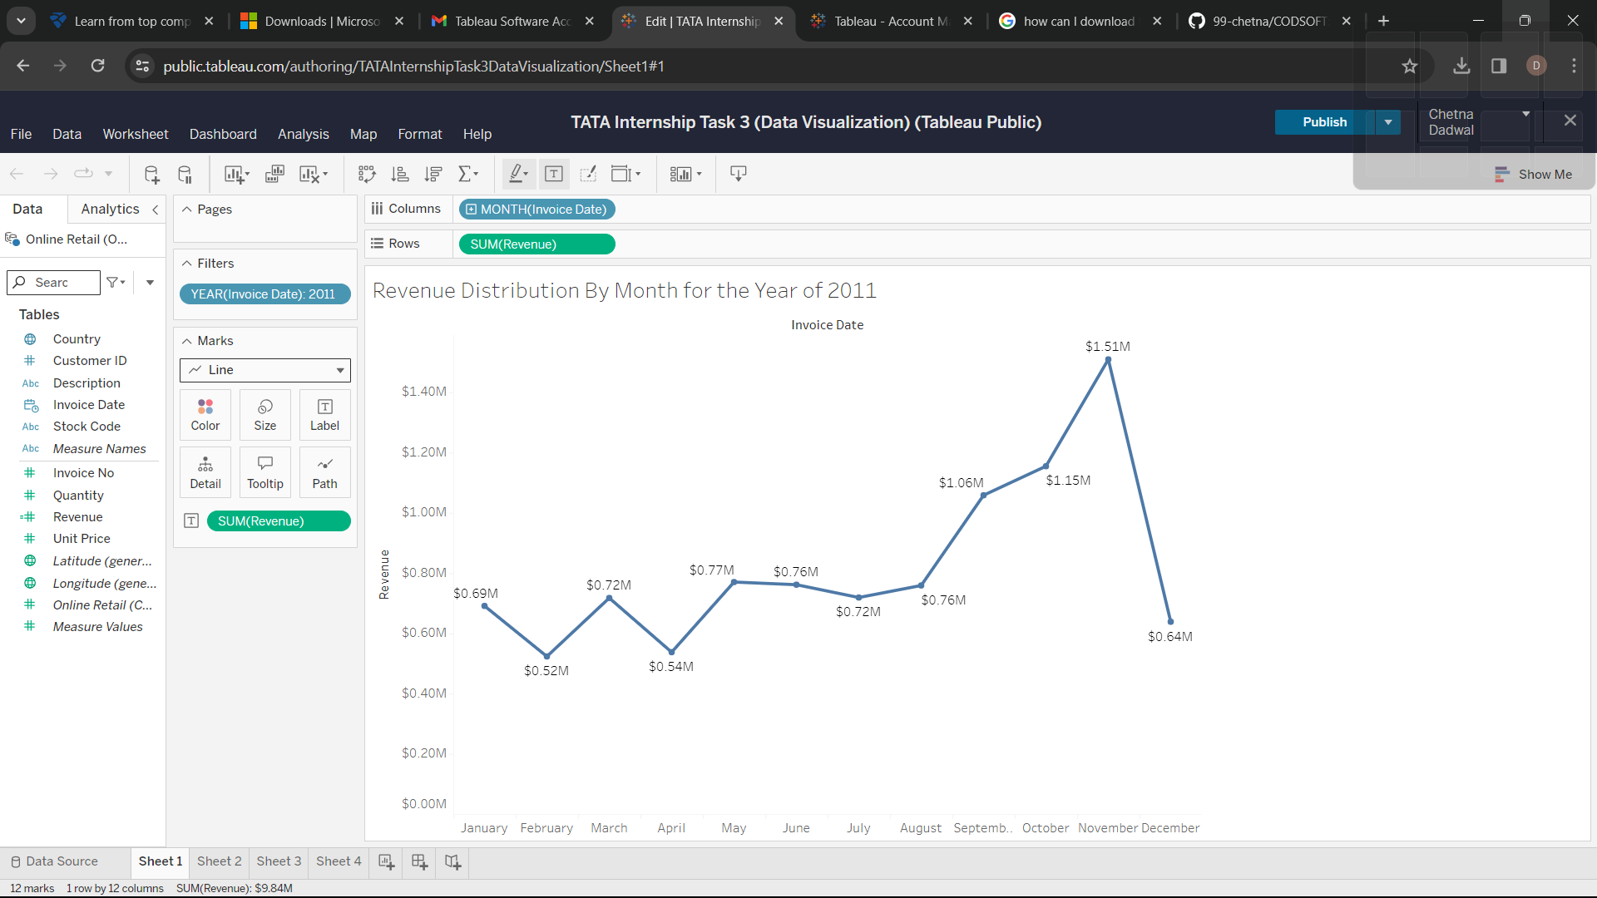
For 8 months sale was stable for the year of 2011 from month of September there was boost in revenue The revenue fluctuation from august to December demonstrates how seson effects sales.
Revenue Distribution By Month for the Year of 2011

Slide 4
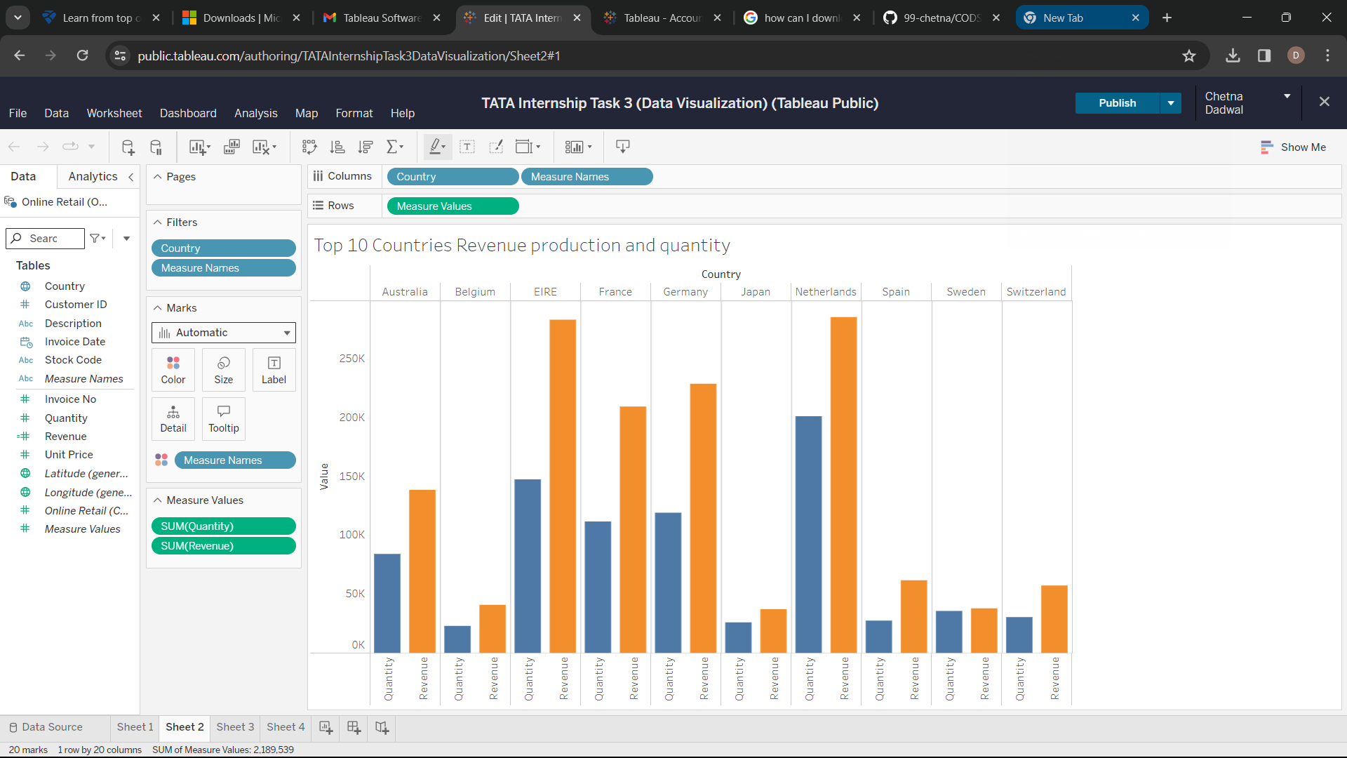
Top 10 Countries revenue production and quantity
This chart represent the Top 10 Countries in terms of revenue production and quantity.
These countries are showing high Purchasing power as there no mjor difference is seen in saling process.
These countries are region where revenue production is more and company can focus on these region to boost up revenue.

Slide 5
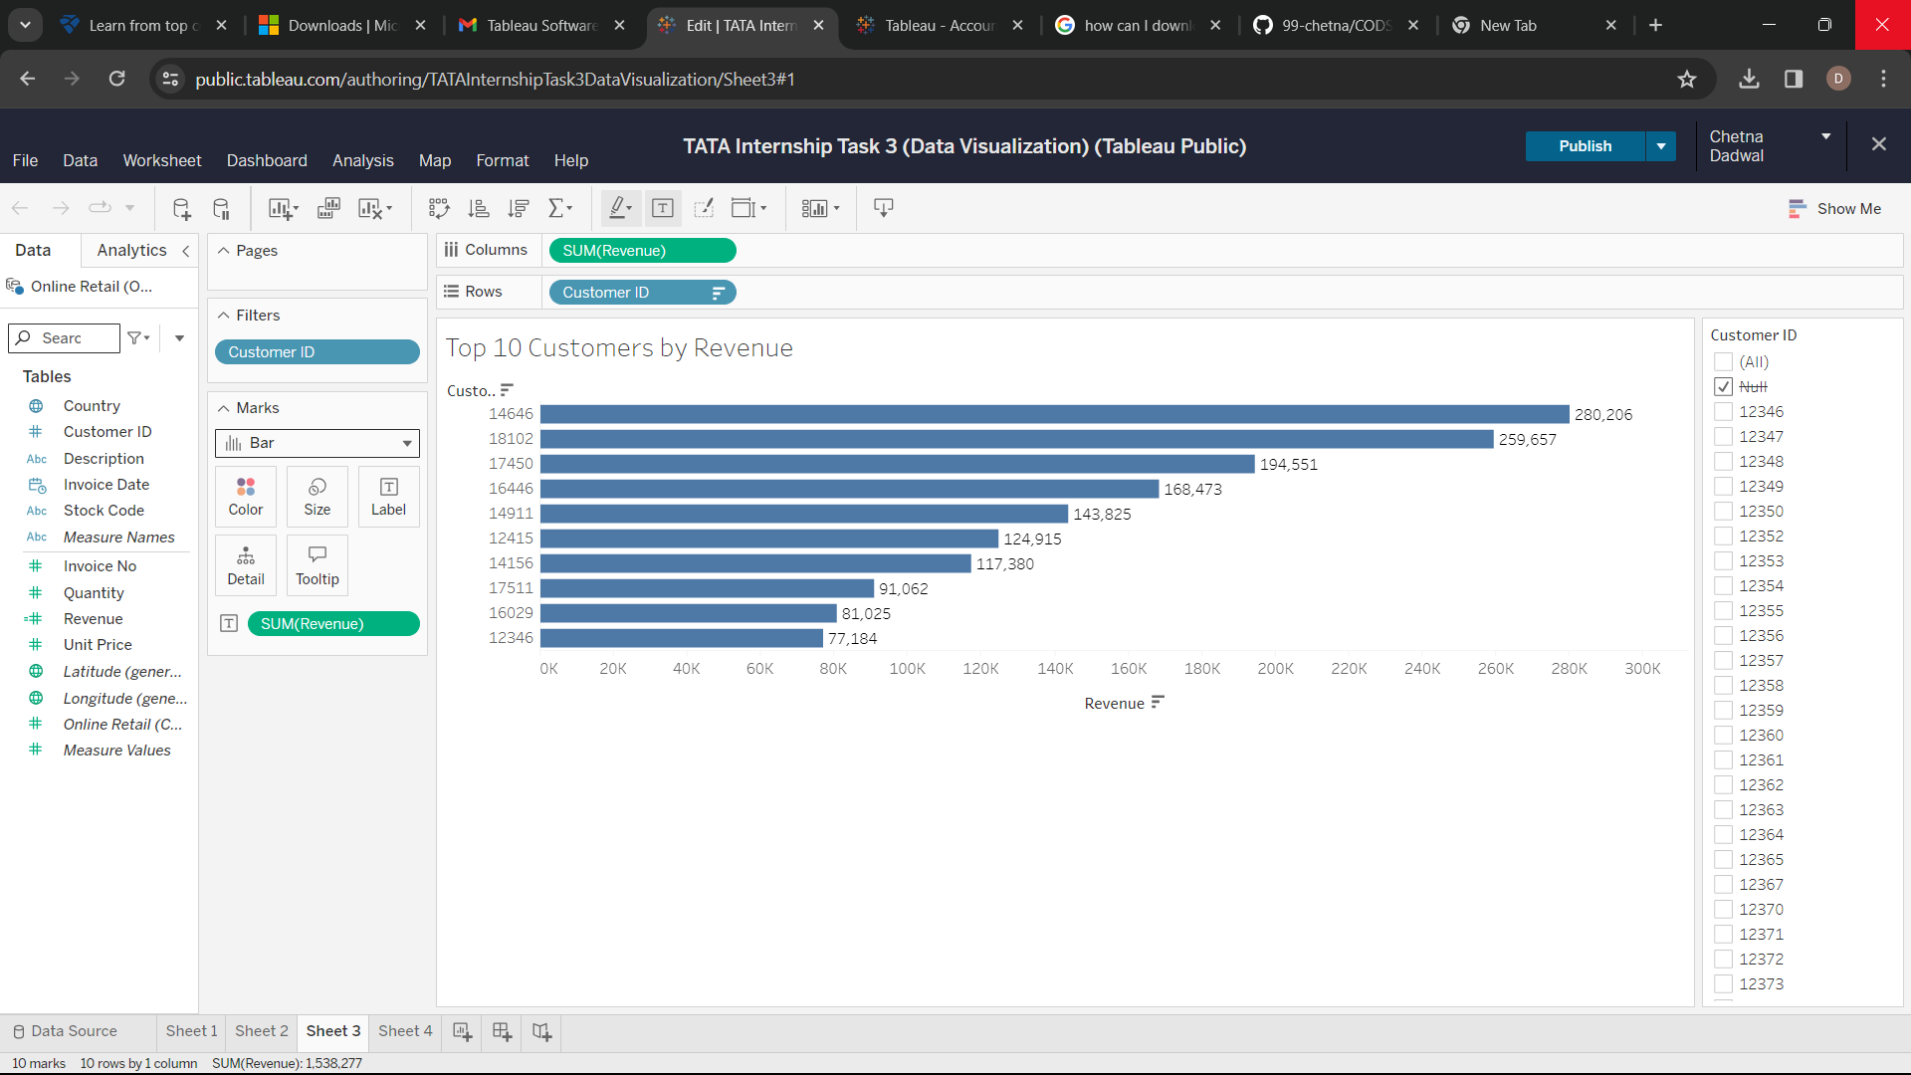
Top 10 Customers by Revenue
This chart represent the Top 10 Customers in terms of revenue production.
The average difference in revenue is 15.38 percent.
It will be good if company try to maintain good relation with these customers by gaining customer loyalty that will help to increase revenue.

Slide 6
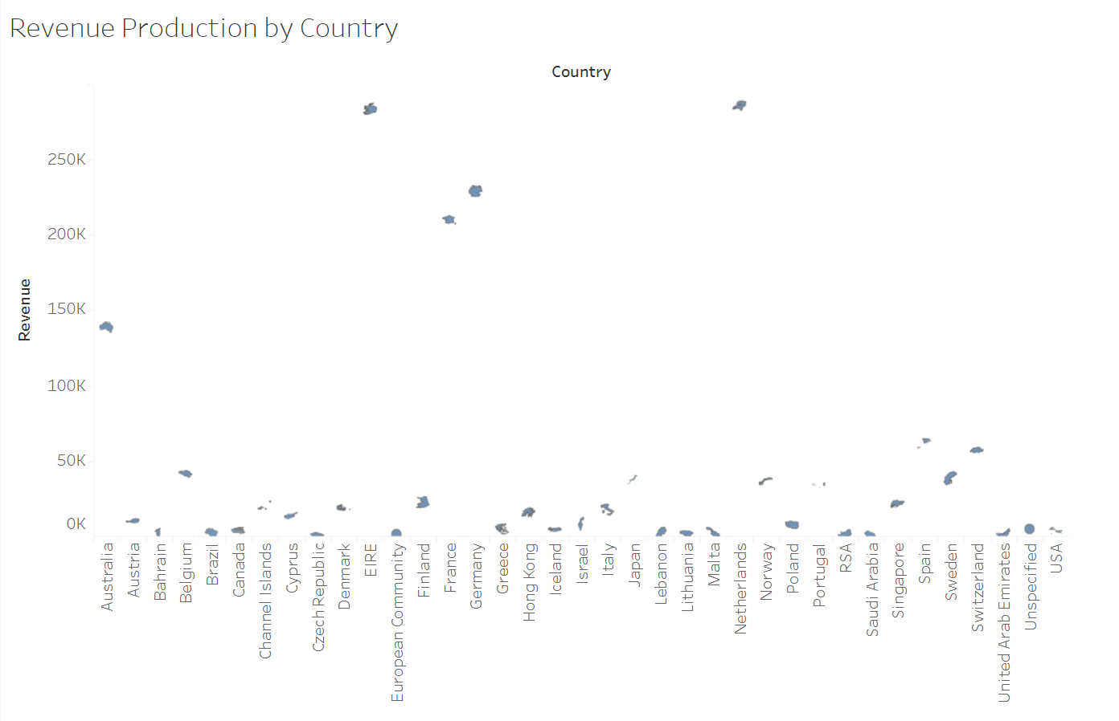
Revenue Production By countries
This Map Chart represent Revenue Production by different Countries.
This also shows most of sale of products in European region and with small number in American and Asian region along with Russia.
Company can focus more on European region .

Slide 7
Exhoration
The company should come up with different strategies that aim at advertising seasonal products to maximize the sale which will be indeed beneficial for company itself.
The company should dig deeper into analysis for which product there is more demand in market during all season.
The company should try to build good relations with customers who play important role for companies revenue production.
The deeper analysis for each region i.e by analyizing which product is most selled in which region
The European market is one of the biggest boost to companies revenue production and company should aim at strategies that will increase its marketing position in region.

